Slide 1

Merry Müsli: are we on the right track?
Group 1: Kevin, Jugnu, Fahad, Pracheta
Notes:
Start calm, think and take a breath before you speak. Don’t panic, because you are doing fine.

Slide 2
Agenda
Status quo
Assumptions & Hypothesis
Workflow
Standard vs Express
Results
Hypothesis testing
Results
Conclusion
Suggestions & Recommendation

Slide 3
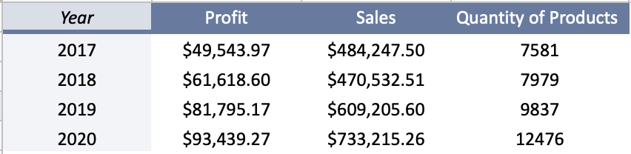
Annual report 2017-2020
Notes:
Annual report:
Growth each year except for 2018-> not much sales but profit still increased to previous year. As well as the sold products in total quantity has increased
Potential upwards
Hype on the oat/muesli products

Slide 4
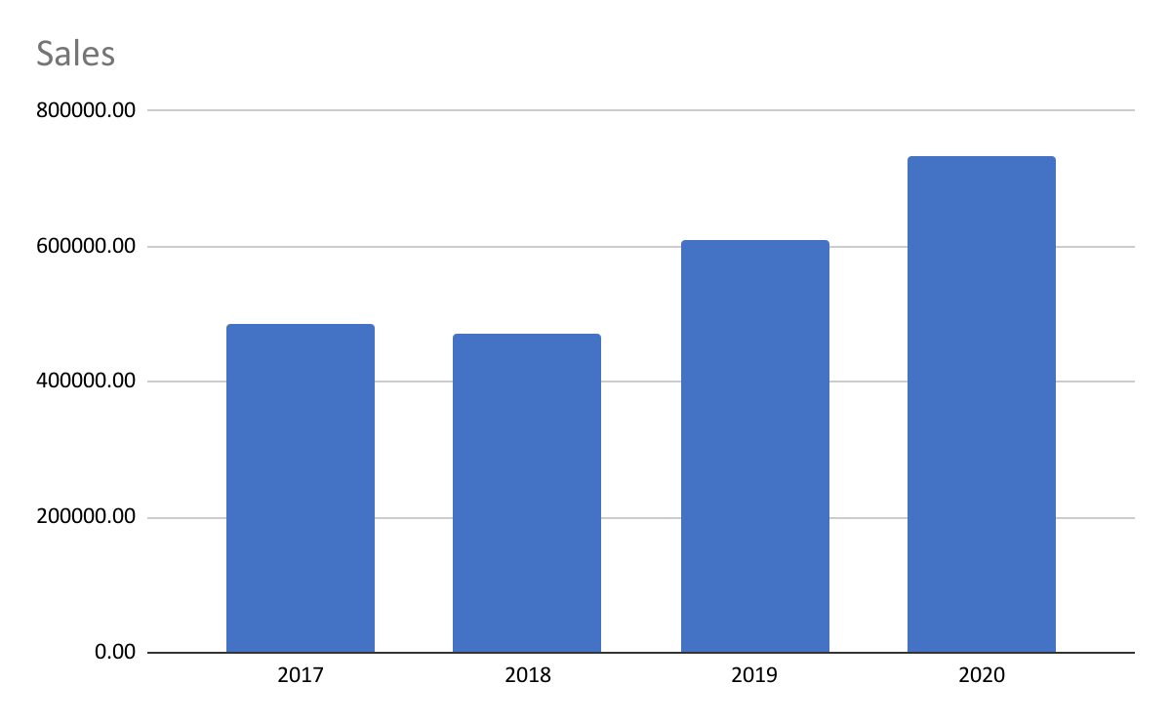
Annual sales 2017-2020
Annual growth positive tendency
Strong positive development last two years
Clearly a very significant healthy business
Notes:
Annual Sales:
Sales growth annually and tendency of positive development for the future

Slide 5
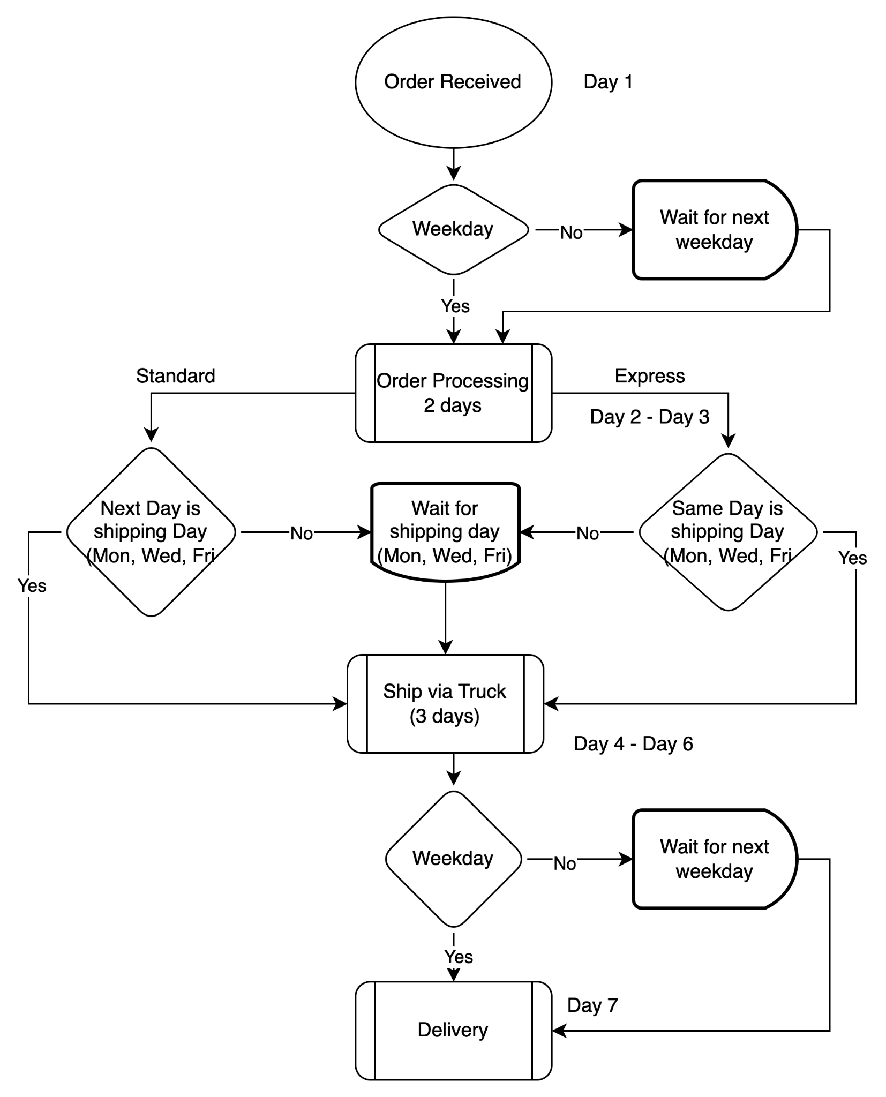

Slide 6
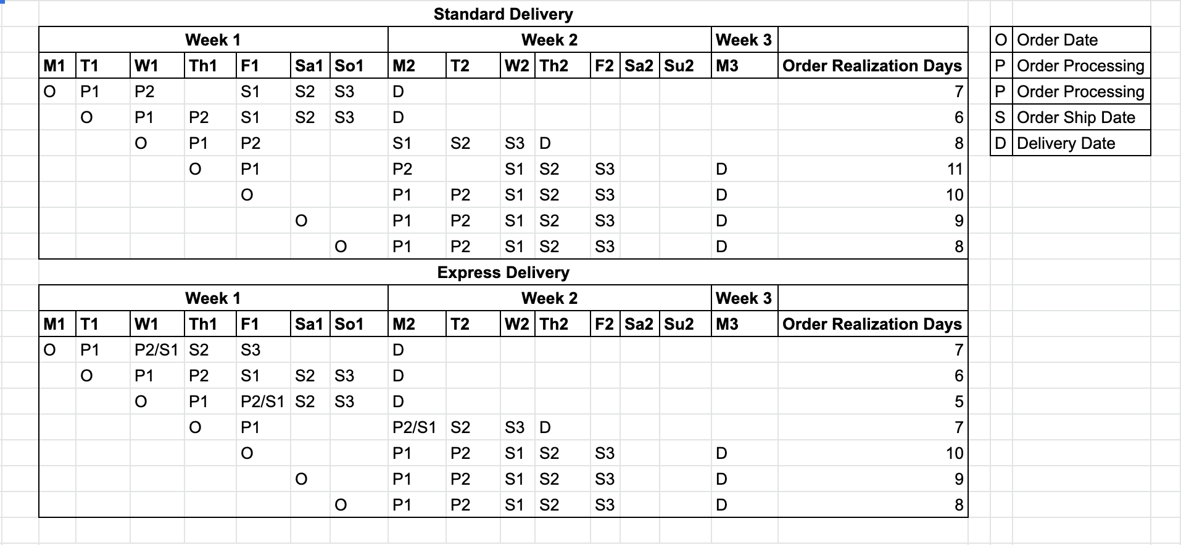
Hypothesis:
Notes:
ASSUMPTIONS OF HOW MUCH TIME A DELIVERY TAKE TO BE COLLECTED BY THE CUSTOMER ACCORDING THE DATA, ACQUIRED FROM THE PROMOTION CAMPAIGN!! DIFFERS BETWEEN EXPRESS AND STANDAR.

Slide 7
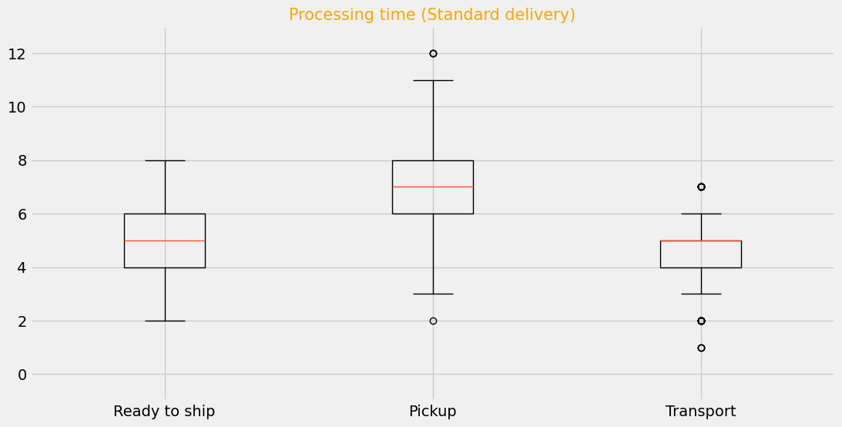
How long does it take?

Slide 8
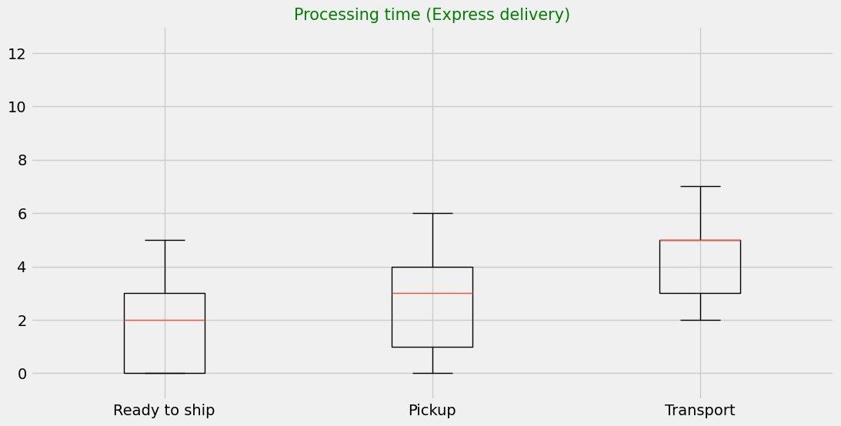
How long does it take?

Slide 9
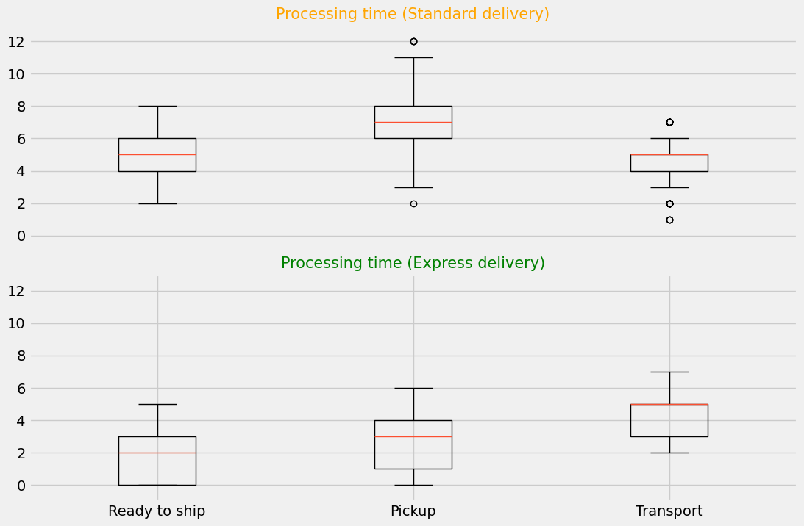
How long does it take?

Slide 10
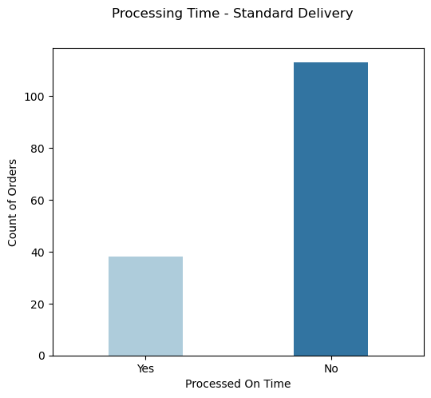
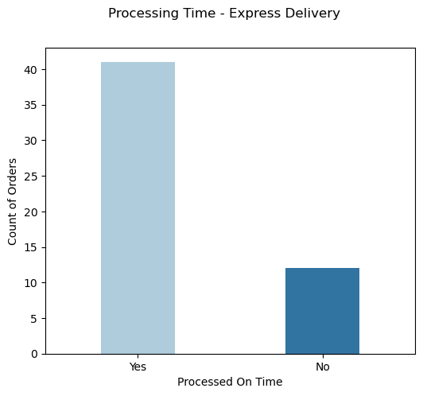
Are orders getting processed on time?
Only 25% on-time processing
77% on-time processing
Order
Ready to ship
Pick-up
Delivery
Notes:
Now, let’s dive deep further to see the impact of the time taken at every step on our orders. First step is processing time. Are they meeting our expectation of processing time? Please note that we have taken weekends into consideration during our analysis.
This data is based on Order date and ready-to-ship date provided in our data. We had complete data on Order date but limited data on ready-to-ship date.
So here we can see how many orders are meeting our expectation when it is labelled as standard and when it is labelled as express
Only 25% orders are getting processed on time when they are labelled as Standard.
But for orders labelled as express, we are doing much better. More than 75% orders are meeting our expectations.
An option can be that probably the order was processed on time and not picked up and it was in the warehouse as ready to ship.
So, we really need to think if processing is our bottleneck in case of standard processing and monitor it closely for our efficiency
50 sec

Slide 11
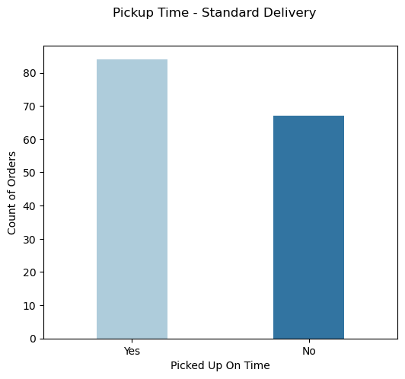
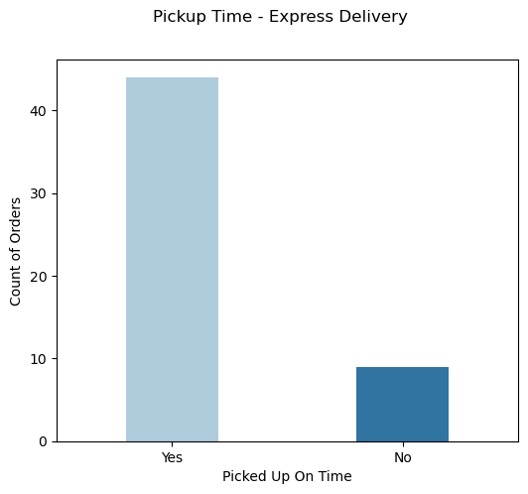
Are orders getting picked-up on time?
55% getting picked up on time
83% getting picked up on time
Order
Ready to ship
Pick-up
Delivery
Notes:
The next step once order is ready to ship, is getting picked up.
The only difference in standard and express is at this level as per the explanation, where the order leaves on the truck the day the order is ready for shipping but days of order pick up is still Mon, Wed and Fri. In standard the pick up is at least from next day onwards when the data was ready to be shipped.
This analysis is based on the ready-to ship date for which we have limited data and truck on scan date for which we have complete data.
It looks better than processing time. For standard 55% are getting picked up on time. For Express, it is even better. 83% are getting picked up on time.
We still have scope of improvement for standard ones. But the question is why there is at all the difference between the two? Are there any limitations on the orders that will be picked up on a single day? Are Standard ones getting ignored?
When we checked the data, there were few discrepancies seen in pick up. The Logistics company is making sure that the pick up is done 3 times a week. But sometimes they skip the day and make it up for some other day. For example on 11 Nov 2020 which was Wed there was no pick up made but instead on 12 Nov 2020 which was Thursday, the pick up was done. And then on 13 Nov 2020 also.
Although such instances are very few and impacted only 4% of our orders. So, at present this could be our secondary issue to look into.
1 min 50 sec

Slide 12
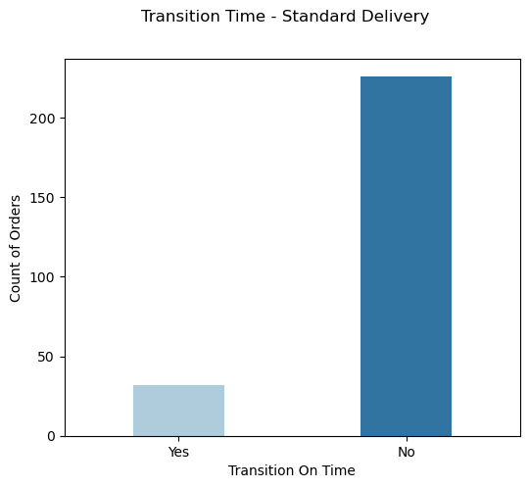

Are orders getting delivered on time?
Only 13% are getting delivered on time.
81% are getting delivered on time.
Order
Ready to ship
Pick-up
Delivery
Notes:
Once the order is picked up the next step is delivery to the customer. We have very limited data on delivery date with an assumption that customers are scanning the marketing promotion code on the same day as received. Moreover the delivery responsibility is completely with Logistics company. As we can see that only 13% orders labelled as standard are getting delivered on time whereas 81% orders are getting delivered on time when labelled as express. So we need to check with the Logistics Company to get the complete insights of the delivery time to further confirm our findings.
35 sec

Slide 13
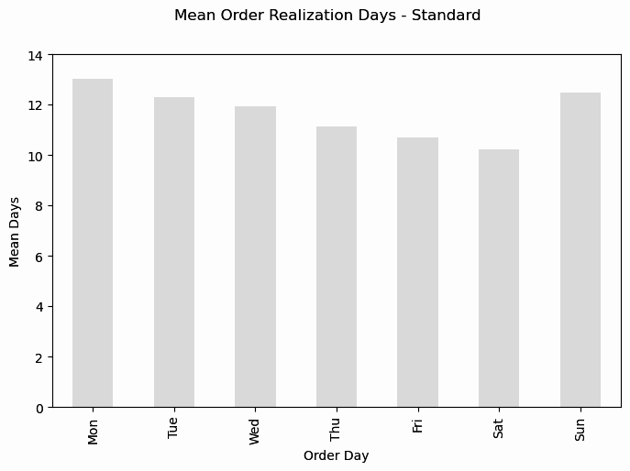
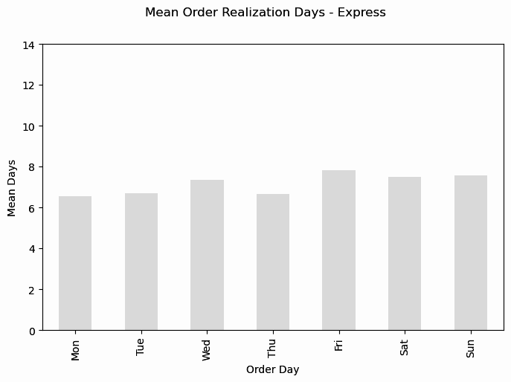
What is the prediction of the whole time?
11 - 13 days
7 - 8 days

Slide 14
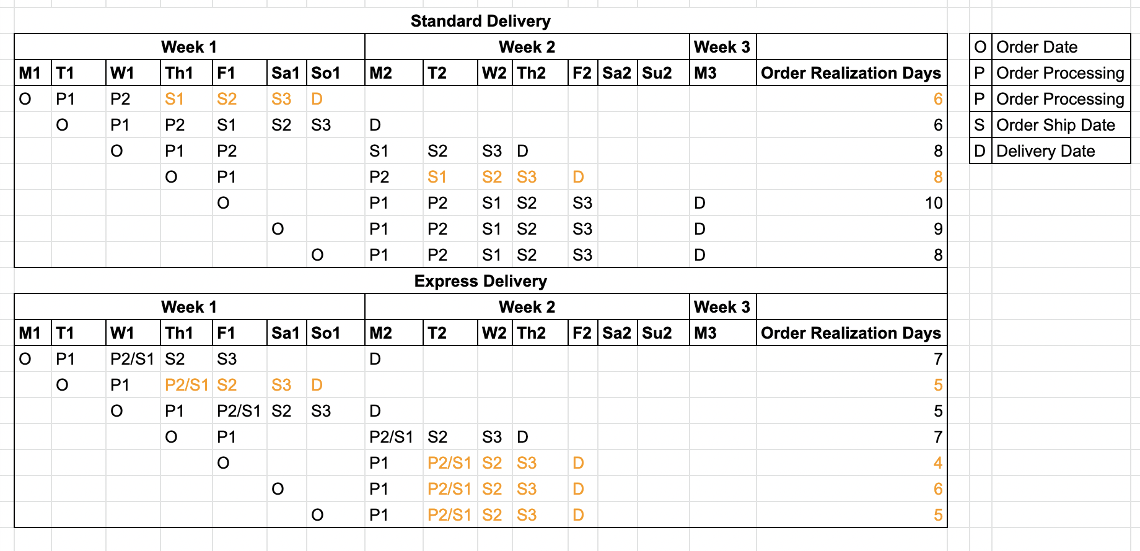
Is it beneficial to have daily Pick up?
8.5 - 7.8 days
7.4 - 5.6 days

Slide 15
Conclusions and Recommendations:
Average order processing time: 10 days.
Check with logistics about the transit time insights.
Order processing time for standard shipping mode needs to be controlled.
The daily pick-up option will have major impact on express mode as compared to standard mode.
Best option is to employ more staff for order processing and consider all the orders as express shipping mode!

Slide 16
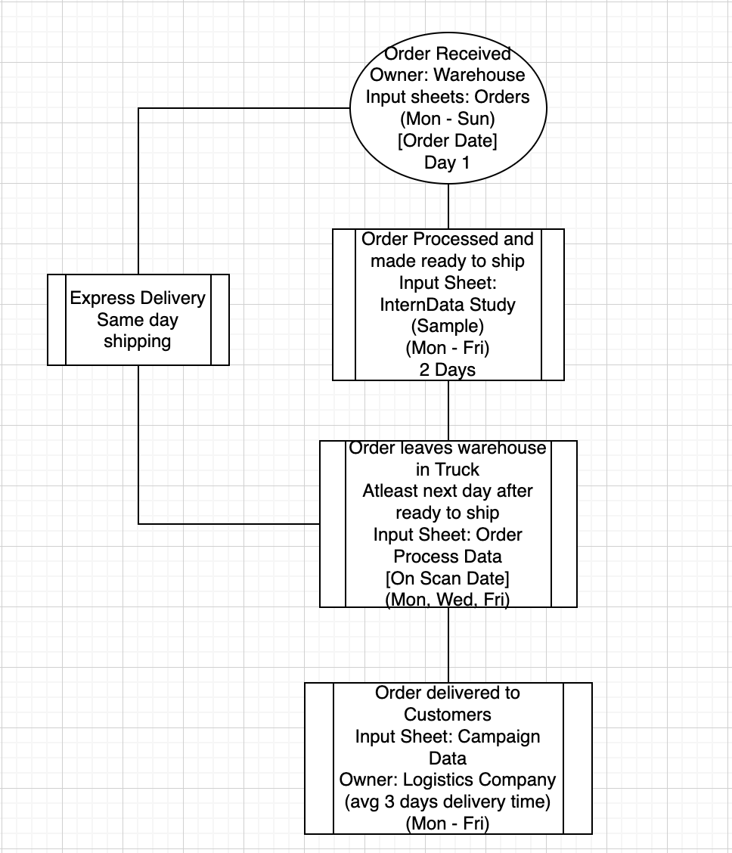
Notes:
Process situation of now! How products are processed depending on express or standard delivery! Priority express!
According to the warehouse process, in average as shown on the workflow chart

